Slide 1
FLIP ROBO Technologies
Data Analysis Presentation
CUSTOMER RETENTION
Submitted By:
HINAL SETH
Batch - Internship 21

Slide 2
PROBLEM STATEMENT
E-retail factors for customer activation and retention: A case study from Indian e-commerce customers
Customer satisfaction has emerged as one of the most important factors that guarantee the success of online stores; it has been posited as a key stimulant of purchase, repurchase intentions and customer loyalty. A comprehensive review of the literature, theories and models have been carried out to propose the models for customer activation and customer retention. Five major factors that contributed to the success of an e-commerce store have been identified as: service quality, system quality, information quality, trust and net benefit. The research furthermore investigated the factors that influence the online customers' repeat purchase intention. The combination of both utilitarian value and hedonistic values are needed to affect the repeat purchase intention (loyalty) positively. The data is collected from the Indian online shoppers. Results indicate the e-retail success factors, which are very much critical for customer satisfaction.

Slide 3
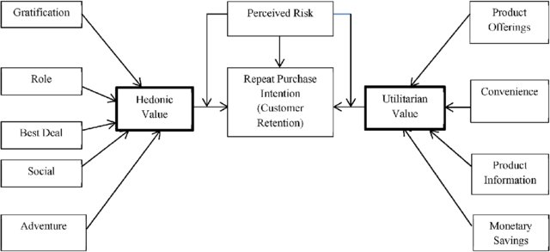
Note: Data Scientists have to apply their analytical skills to give findings and conclusions in detailed data analysis written in jupyter notebook . Only data analysis is required.

Slide 4
Understanding
If executed properly, a data-driven approach to customer retention may produce significant results. In fact, it has been demonstrated to be a profitable strategy. We're here to perform a descriptive and diagnostic analysis, which entails looking back at the past to identify patterns and trends that might help us explore further into the problem. As a final benefit, it helps us understand why something happened, such as examining churn indications and customer usage trends.

Slide 5
EDA Steps
First we import libraries and upload the data from excel sheet to jupyter notebook. Once done the said data will be loaded on Data Frame(df). In order to further understand the data we print some samples. The print will help check features like rows, columns, data types etc.. In the said study we have –
Total no. of rows = 269
Total number of columns = 71
We also check for null values but there are none.

Slide 6
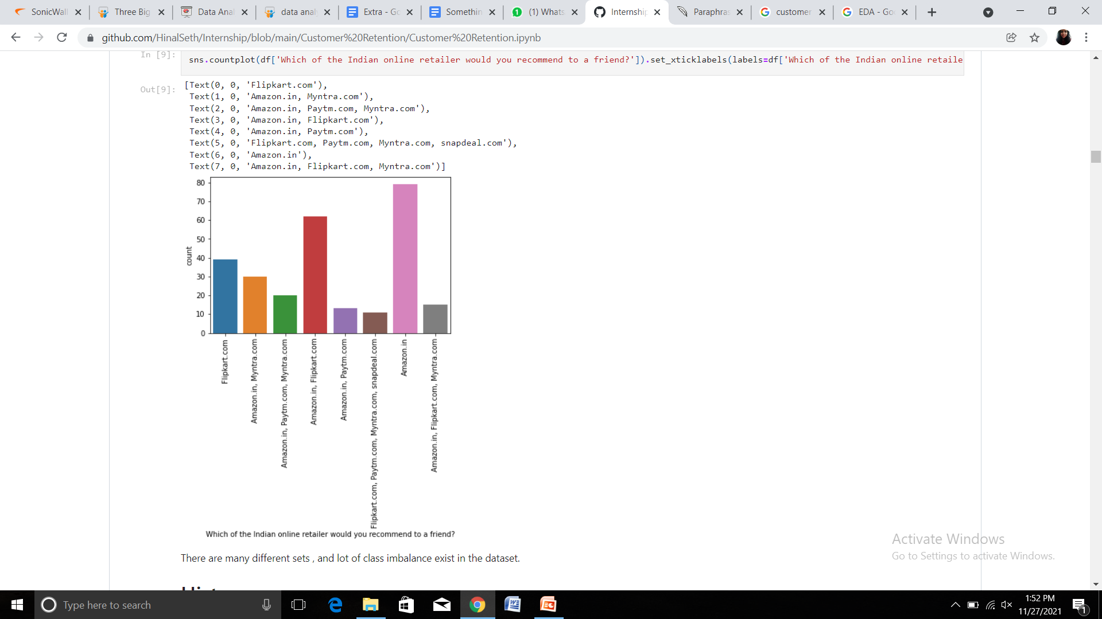
We plot countplot of our target variables and find out that there exists class imbalance which we will have to treat for training the data and testing it later.
Univariate Analysis : Countplot
A countplot show the counts of observations in each categorical bin using bars .
Here we have 8 different observations and we can see that the maximum count is of Amazon and Flipkart.

Slide 7
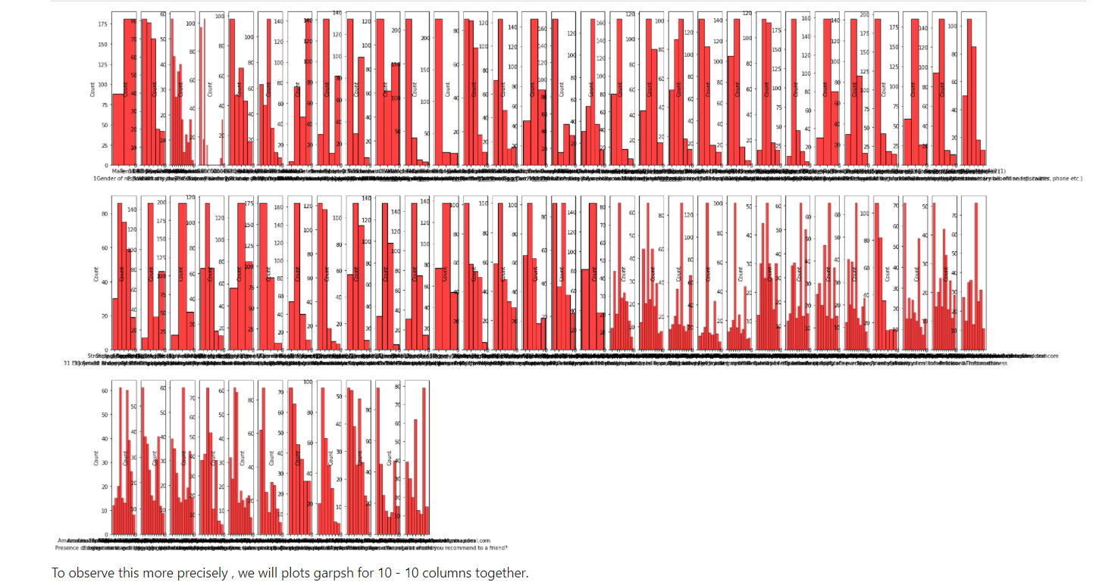
Univariate Analysis : Histogram

Slide 8
Now, by the histogram we have plotted we came to know that the following 17 columns are necessary elements of our dataset and we can drop rest all. The shortlisted columns are as follows:
Gender of respondent
How many times have you made an online purchase in the past 1 year?
Which channel did you follow to arrive at your favorite online store for the first time?
What is your preferred payment option?
How frequently do you abandon (selecting an items and leaving without making payment) your shopping cart?
Complete information on the listed seller and product being offered is important for purchase decisions.
Ease of navigation in website

Slide 9
8. User friendly interface of the website
9. Convenient payment methods
10. Responsiveness, availability of several communications channels (email, online rep, twitter, phone etc.)
11. Online shopping gives monetary benefit and discounts
12. Return and replacement policy of the e-trailer is important for purchase decision
13. Offering a wide variety of listed product in several category
14. Net benefits derived from shopping online can lead to customer satisfaction.
15. Getting value for money spent
16. Easy to use website or application
17. Which of the Indian online retailers would you recommend to a friend?

Slide 10
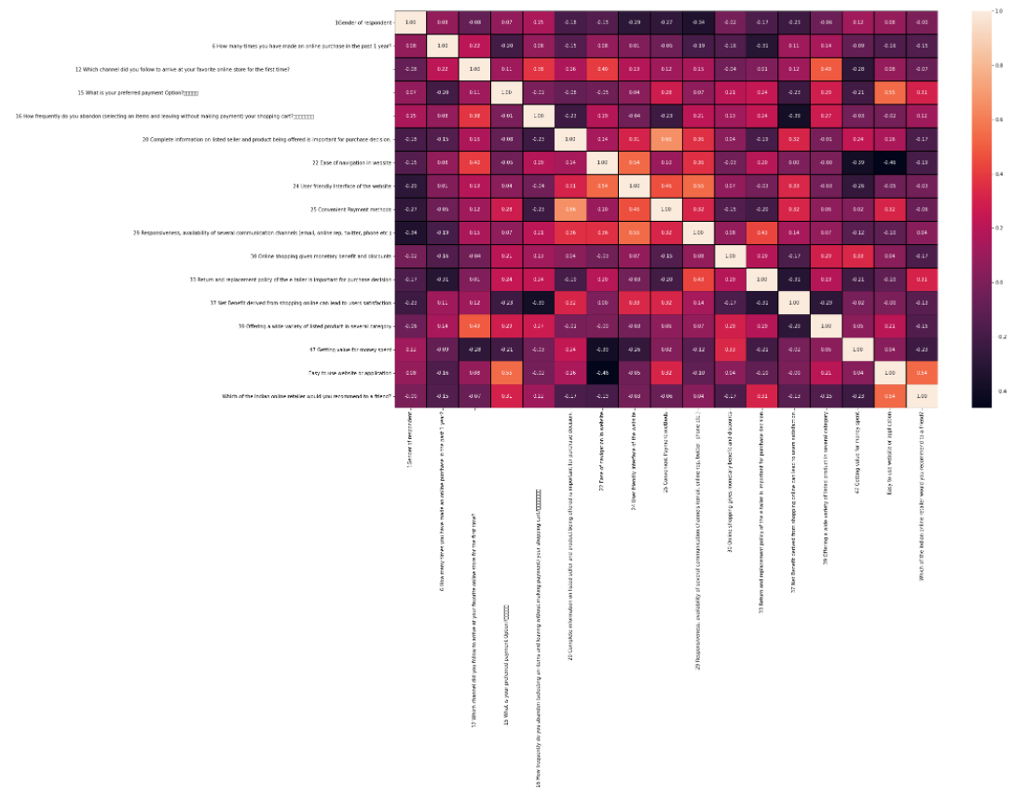
Now we will encode this categorical data of 17 columns into ordinal data to generate a heat map.
Multivariate Analysis : Heat map
The blocks with the darkest colors have least collinearity which is important for our analysis, and the blocks with the lightest columns have maximum co-llinearity. And no multi-collinearity exists in our Datasheet.
After studying the heat map closely we can choose the columns that have maximum collinearity with our target column and lastly we perform Bi-variate analysis on each one of them.

Slide 11
The following columns have the maximum collinearity with our data
What is your preferred payment option?
Responsiveness, availability of several communication channels (email, online rep, twitter, phone etc..)
Return and replacement policy of the e-trailer is important for purchase decisions.
Net benefits derived from shopping online can lead to user satisfaction.
Easy to use websites or applications.
Now lets analyze them one by one with the help of graph

Slide 12
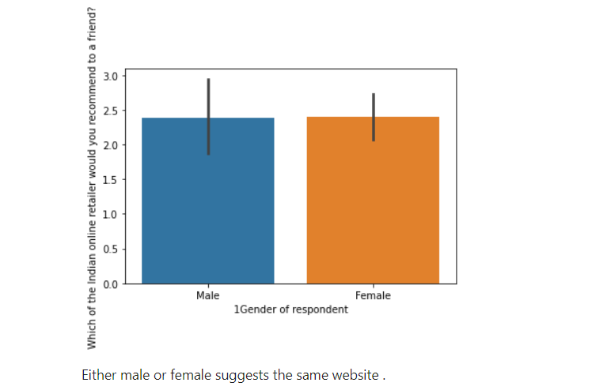
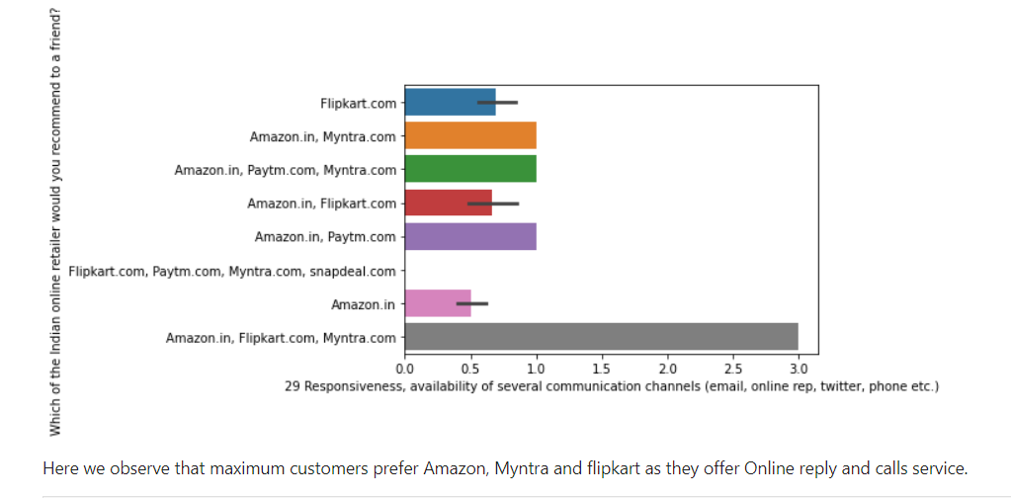
Bivariate Analysis
1. Gender of respondent?
Both female and male suggested the same website .
And they’ve preferred the same payment methods
Online Payment > Cash on Delivery > Other options
2. Responsiveness, availability of several communication channels (email, online rep, twitter, phone etc..)
Here we observe that maximum number of people tend to prefer Amazon, Myntra and Flipkart as they offer good customer care services.

Slide 13
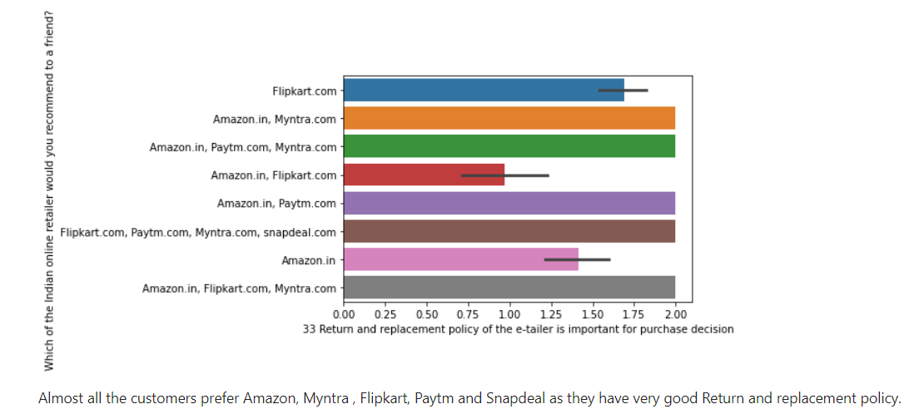
3. Return and replacement policy of the e-trailer is important for purchase decisions
Amazon, Myntra and Flipkart offer good return and replacement policies that attract a lot of customer to their store and purchase freely.

Slide 14
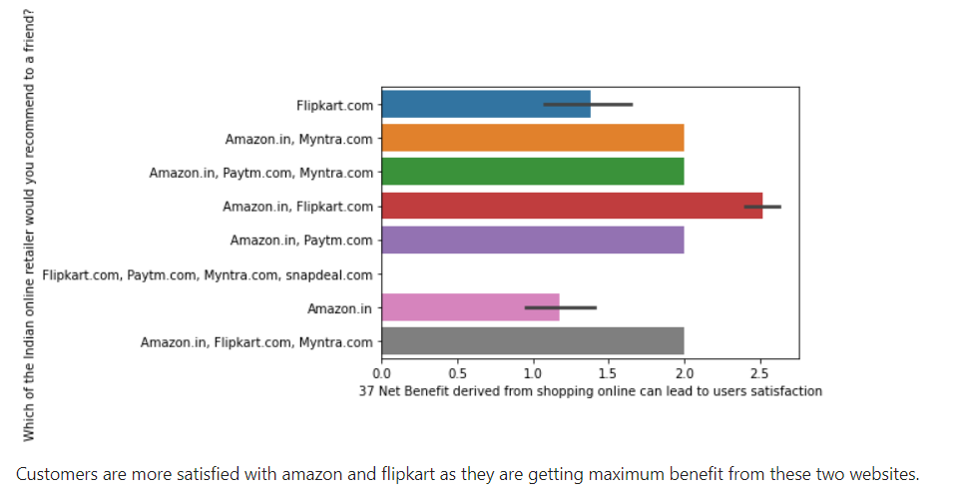
4. Net benefits derived from shopping online can lead to user satisfaction.
Customer are highly satisfied from the products and policies and customer care services provided by Amazon and Flipkart.

Slide 15
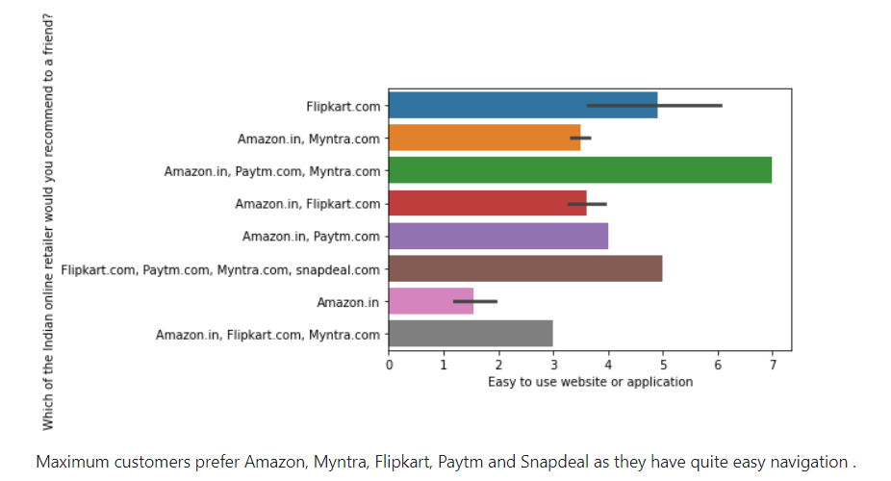
5. Easy to use websites or applications.
Amazon, Flipkart, Myntra, Paytm and Snapdeal are at the top when it comes to easy use of their websites. Customer love their easy use online platform and engage with the services more often because of that.

Slide 16
Conclusion
For a company or product, customer retention is the capacity to keep its consumers for a specified amount of time. If a product or business has a high customer retention rate, it suggests that consumers will keep using and purchasing the product or service. Customer defections are a major concern for most marketing organizations. When it comes to customer retention, the initial encounter a business makes with a customer is just as important as the full lifecycle of the relationship. Customer engagement and retention are not just dependent on a company's product or service, but rather on its customer service procedures, the relative benefits of its solutions, and its reputation within and outside of the marketplace.
Based on our study, a customer prefers to surf at least two websites before making a purchase. Most trustable websites to purchase products from are Amazon, Flipkar, Myntra, and finally Snapdeal. The most trusted way of online payment is from Paytm. These are popular websites because of their easy use interface. Their access to better replacement policies and cashback returns. Their secure and protected payment gateway. These websites thrive to provide fast and good customer care services that work 24x7 for the satisfaction of their customers.

Slide 17
THANK YOU

